Slide 1


UNIVERSITY OF BASRA
COLLEGE OF MEDICINE
DEPARTMENT OF PATHOLOGY AND FORENSIC Medicine
Normochromic Normocytic
Anaemias
Dr. Ala’a A.Razak Abood
Iraqi Board of Haematopathology

Slide 2
objectives:
1- Definition of normocytic anemia with its underlying cause.
2- Definition of haemolytic anemia, causes, mechanism of cell destruction
3- haemolytic anemia due to hereditary cause haemoglobin abnormalities.
4- haemolytic anemia due to hereditary red cell membrane abnormalities.
5- haemolytic anemia due to defective red cell metabolism

Slide 3
Definition:
Normochromic normocytic anemia is a form of anemia in which the average size and hemoglobin content of the red blood cells are within normal limits.

Slide 4
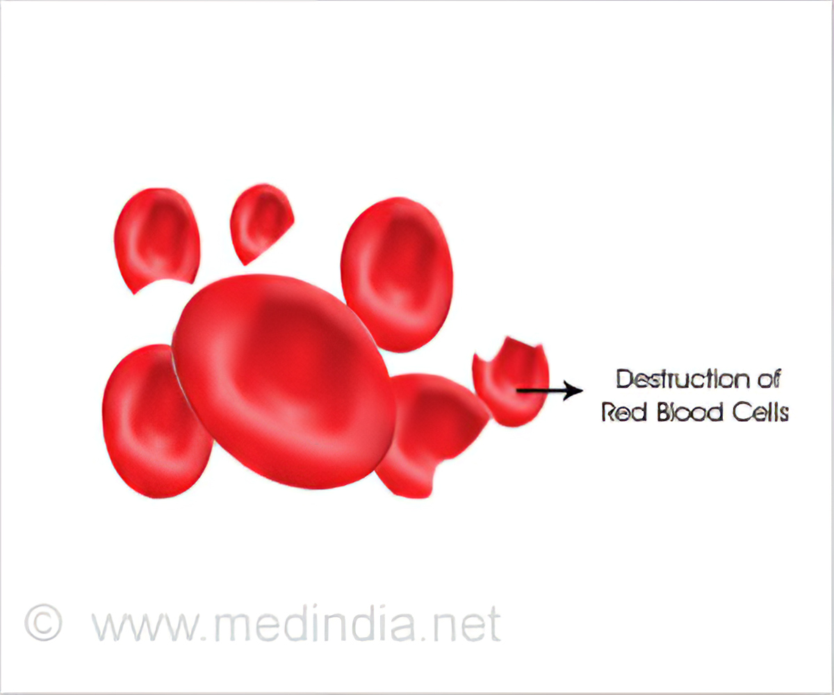
Hemolytic Anemia

Slide 5
Definition:
Haemolytic anaemias are defined as those anaemias that result from an increase in the rate of red cell destruction.

Slide 6
Classification of haemolytic anemia:
According to the underlying cause (Pathogenesis):

Slide 7
According to the site of RBC breakdown (Mechanism of haemolysis)

Slide 8
Clinical feature of haemolytic anemia:
Pallor of the mucous membranes
fluctuating jaundice
splenomegaly.
Dark color urine ?????.
Pigment (bilirubin) gallstones.
Ulcers around the ankle.
Aplastic crises.

Slide 9
Laboratory findings in haemolytic anemia:
Features of increased red cell breakdown:
Features of increased red cell production:
Damaged red cells:

Slide 10

Hereditary haemololytic anemia due to Genetic disorders of Haemoglobin

Slide 11
Haemoglobin abnormalities:
These result from the following:
1 - Synthesis of an abnormal haemoglobin:
(Hb S, Hb C, Hb D )
2 - Reduced rate of synthesis of normal α - or β - globin chains:
(the α - and β - thalassaemias).

Slide 12


Slide 13
Definition:
Sickle cell disease is a group of haemoglobin disorders resulting from the inheritance of the sickle β -globin gene.
A, adenine; C, cytosine; G, guanine; glu,glutamic acid; pro, proline; T, thymine; val, valine.

Slide 14
Pathophysiology of sickle cell disease:

Slide 15
Clinical features of homozygous sickle cell anemia:
1- Vaso-occlusive crises

Slide 16
2- Visceral sequestration crises
3- Aplastic crises.
4- Haemolytic crises

Slide 17
Laboratory findings in homozygous sickle cell anemia

Slide 18
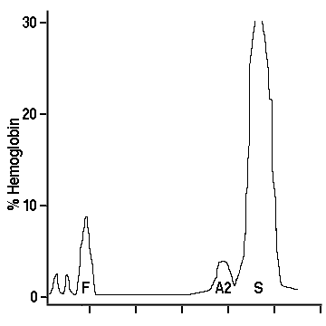

Slide 19
Sickle cell trait :
This is a benign condition with no anaemia and normal appearance of red cells in a blood film.
Haematuria is the most common symptom.
Hb S varies from 25 to 45% of the total haemoglobin.
Care must be taken with anaesthesia, pregnancy and at high altitudes.

Slide 20
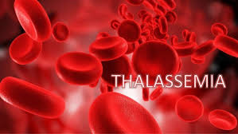

Slide 21
Definition:
These are a heterogeneous group of genetic disorders that result from a reduced rate of synthesis of α or β chains.

Slide 22
Classification:

Slide 23
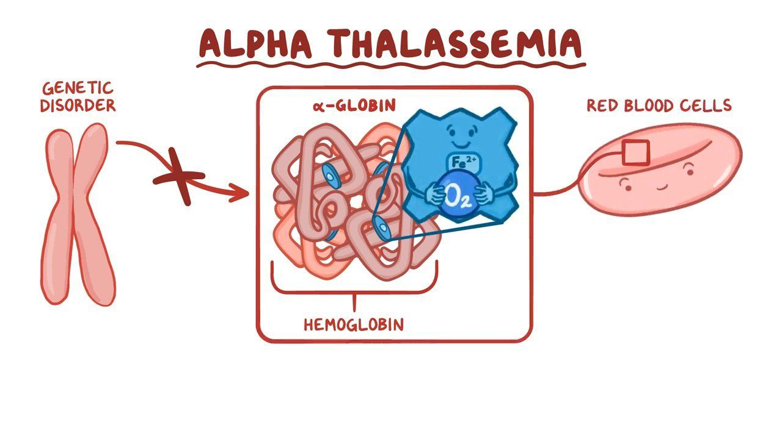

Slide 24
These are usually caused by gene deletions.
As there are normally four copies of the α - globin gene, the clinical severity can be classified according to the number of genes that are missing or inactive:

Slide 25
Loss of all four genes completely - suppresses α - chain synthesis is incompatible with life and leads to death in utero hydrops fetalis.

Slide 26
2. Three α gene deletions leads to a moderately severe (haemoglobin 7 – 11 g/dL) microcytic, hypochromic anaemia with splenomegaly.
This is known as Hb H disease.

Slide 27
3. The α - thalassaemia traits :
- caused by loss of one or two genes and are usually not associated with anaemia, the mean corpuscular volume (MCV) and mean corpuscular haemoglobin (MCH) are low and the red cell count is over 5.5 × 10 12 /L. Haemoglobin electrophoresis is normal and DNA analysis is needed to be certain of the diagnosis.

Slide 28
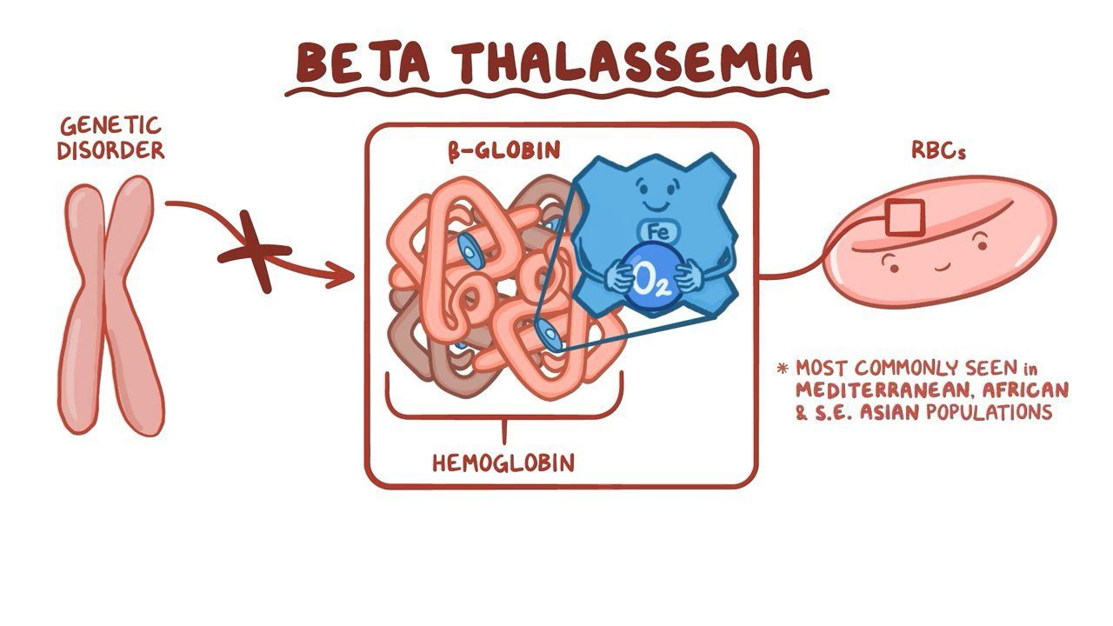

Slide 29
β - Thalassaemia major

Slide 30
Clinical features of beta thalassemia major:

Slide 31
Laboratory diagnosis of beta thalassemia major:
1- There is a severe hypochromic microcytic anaemia, raised reticulocyte percentage with normoblasts, target cells and basophilic stippling in the blood film

Slide 32
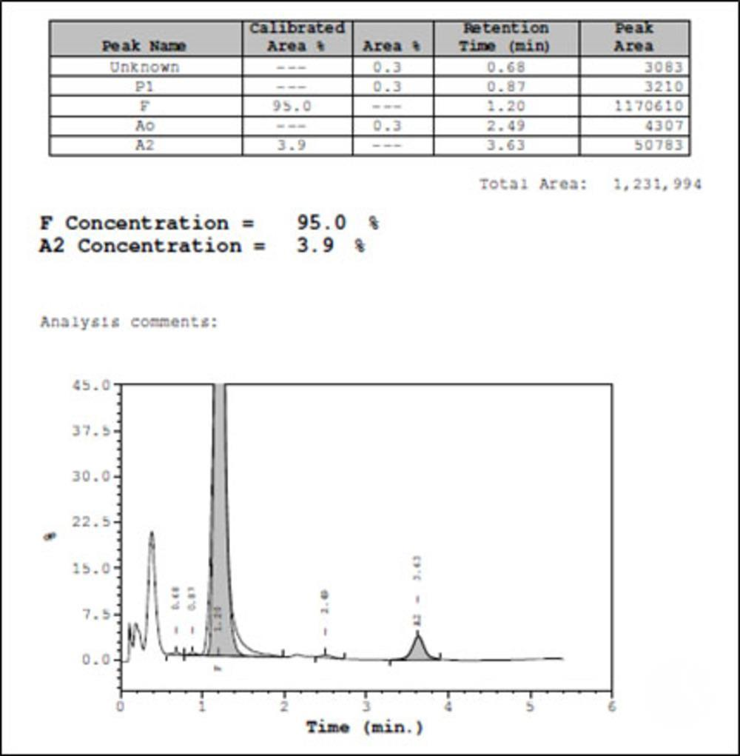
2- High performance liquid chromatography (HPLC) reveals absence or almost complete absence of Hb A, with almost all the circulating haemoglobin being Hb F. The Hb A 2 percentage is normal, low or slightly raised.

Slide 33
β - Thalassaemia minor
Hypochromic microcytic blood picture (MCV and MCH very low) but high red cell count (> 5.5 × 10 12 /L) and mild anaemia (haemoglobin 10 – 12 g/dL).
A raised Hb A 2 (> 3.5%) confirms the diagnosis.

Slide 34
β - Thalassaemia intermedia

Slide 35
Hereditary haemololytic anemia due to membrane defects

Slide 36
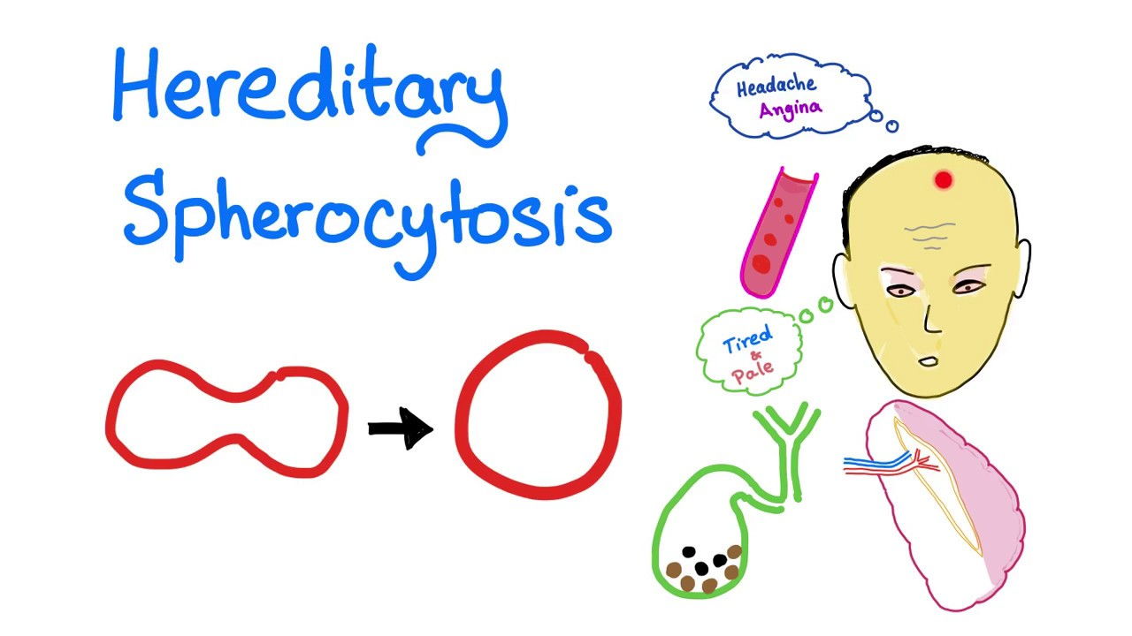

Slide 37
Definition:
It is a heterogeneous disorder due to red cell membrane structural abnormalities result in spherical shaped poorly formed red cells.

Slide 38
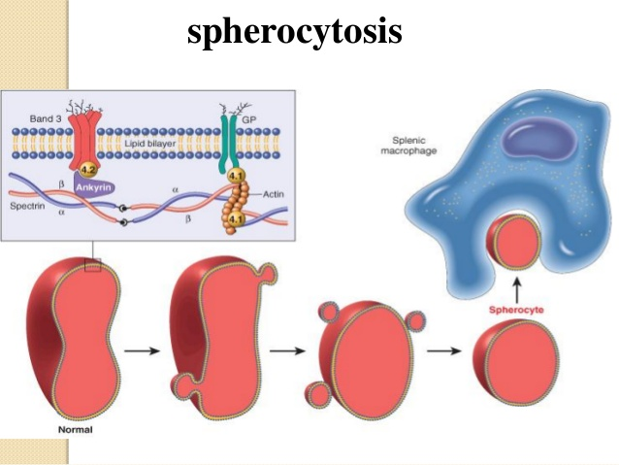
pathogenesis:

Slide 39
Clinical Features:
The inheritance is autosomal dominant.
The anaemia can present at any age.
Jaundice is typically fluctuating.
splenomegaly occurs in most patients.
Pigment gallstones are frequent.
Aplastic crises

Slide 40
Haematological findings:

Slide 41
Hereditary haemololytic anemia due to defective red cell metabolism

Slide 42
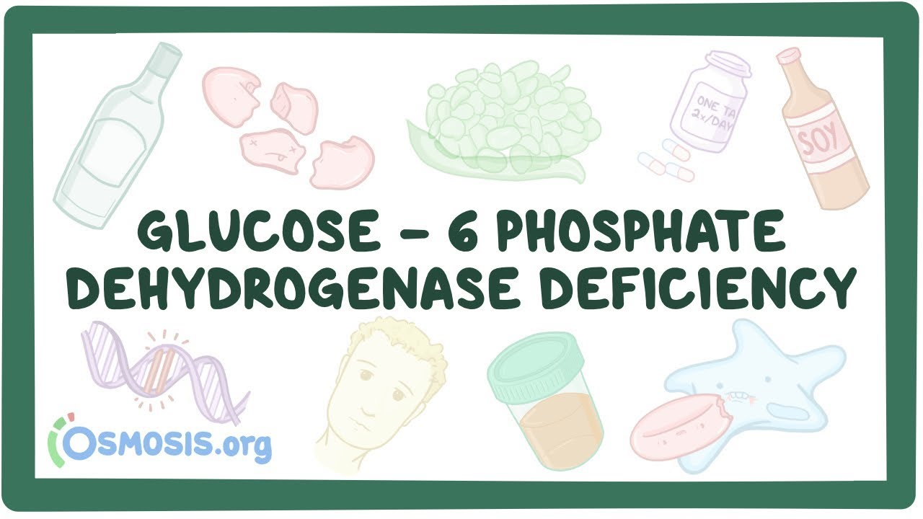

Slide 43
Role of G6PD:

Slide 44
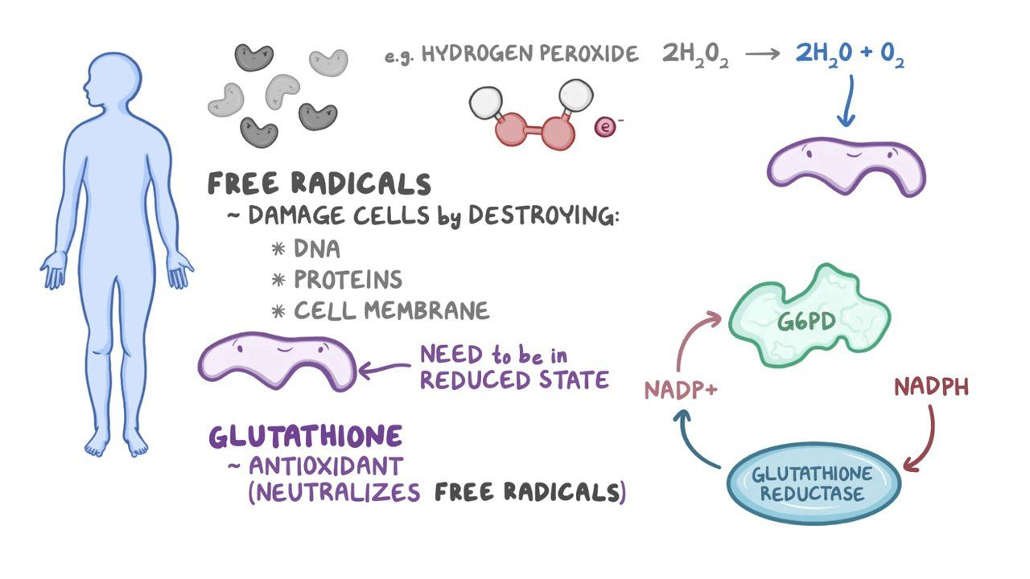
Pathogenesis of haemolytic anemia in G6PD deficiency:

Slide 45
Clinical features of G6PD deficiency:
1- Acute haemolytic anaemia in response to oxidant stress

Slide 47
2- Neonatal jaundice.
3- Congenital non - spherocytic haemolytic anaemia

Slide 48
Diagnosis of G6PD deficiency:

Slide 49


